Slide 1
PHYS 5350 techniques in materials characterization
Auger electron spectroscopy

Slide 2

Primary beam
(source)
Secondary beam
(result)
Photons
Electrons
Ions
Phonons
…
Photons
Electrons
Ions
…

Slide 3
Content
Auger electron spectroscopy
Background
  Electron beam interaction
  Auger process
  Nomenclature
Instrumentation
  Electron beam
Spectral Interpretations
  Qualitative analysis
    Energy of Auger transition
    Intensity of Auger electrons
    Element identification
    Chemical state information
    SEM and Auger images
  Quantitative analysis
    Signal quantification
    Depth profile

Slide 4
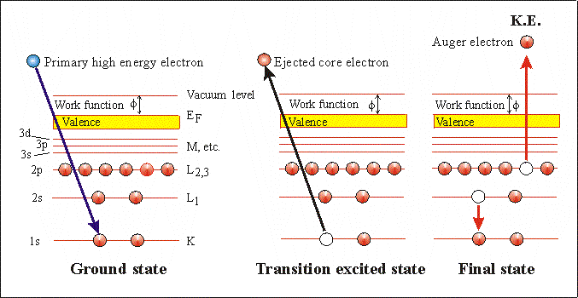
Auger electron spectroscopy: principle
Auger process
The basic Auger process starts with the removal of an inner shell electron, leaving a vacancy (hole). Several processes are capable of producing the hole, but bombardment with an electron beam is the most common one. The hole is filled by a second electron from an outer shell, with excess energy simultaneously released. A third electron, the Auger electron, escapes carrying the excess energy in a radiationless process. Such a process of an excited atom decaying into a doubly charged ion by ejection of electrons is called the Auger process.

Slide 5
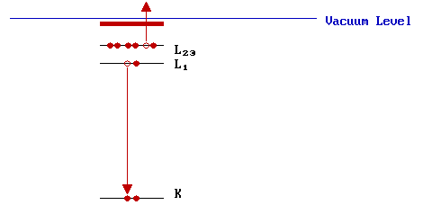
Auger electron spectroscopy: principle
Step 1: Ionization
In AES: a beam of high energy electrons (in the range 2 - 10 keV). Such electrons have sufficient energy to ionize all levels of the lighter elements, and higher core levels of the heavier elements.
In XPS: Soft X-rays ( hν = 1-2 keV ).
Step 2: Relaxation : Auger emission or X-ray fluorescence
Measure kinetic energy of emitted low energy Auger electron (50eV-1.5keV)
KE = ( E_{K} - E_{L1} ) - E_{L23} - φ = E_{K} - ( E_{L1} + E_{L23} ) -φ
-Three electron process, leaving doubly ionized state
Independent of the mechanism of initial core hole formation.
In other words, independent of the energy of the incident beam.
Notes:
Why XPS is not used for Auger analysis?
Why the AES beam energy 2-10keV is higher than that of XPS source?

Slide 6
AES: Nomenclature
V | Valence
N7 | 4f_{7/2}
N6 | 4f_{5/2}
N5 | 4d_{5/2}
N4 | 4d_{3/2}
N3 | 4p_{3/2}
N2 | 4p_{1/2}
N1 | 4s
M5 | 3d_{5/2}
M4 | 3d_{3/2}
M3 | 3p_{3/2}
M2 | 3p_{1/2}
M1 | 3s
L3 | 2p_{3/2}
L2 | 2p_{1/2}
L1 | 2s
K | 1s
Nomenclature
The three symbols in the transition label correspond to the three energy levels involved in the transition.

Slide 7
Auger electron spectroscopy: why electron source
Why we use high energy electron source instead of X-ray source to ionize atoms during the AES (Auger Electron Spectroscopy) experiments:
The reaction cross-section of electron with atoms are much higher than that of X-ray.
Electron sources are cheap.
Electron beam can be focused while X-ray cannot easily be focused. (better lateral resolution).
Energy consumption of electron source is lower.
X-ray radiation is much more hazardous than electron beam.

Slide 8

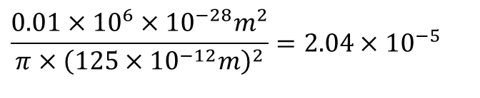
http://xdb.lbl.gov/
Al σ_{2s}=0.01Mb/atom; Al: r=125pm
hν=1253.6eV (Mg Kα)
When one photon hit the atom,
the probability for one 2s electron being kicked out is:
$$\frac{0.01×10^{6}×10^{−28}m^{2}}{π×{\left(125×10^{−12}m\right)}^{2}}=2.04×10^{−5}$$
Notes:
Mb/atom stands for megabarn per atom, a unit used in atomic and nuclear physics to express photoabsorption or photoionization cross sections on a per-atom basis.
One barn (b) equals ${10}^{−28}$ m² or 100 fm², roughly the geometric cross-sectional area of a uranium nucleus, so 1 Mb = ${10}^{6}$ b = ${10}^{−22}$ m²

Slide 9

X-ray Mg Kα=1253.6eV: σ_{Al,total}~10⁻²⁰cm²/atom, reaction rate: ~0.001%
2keV electron: σ_{Al,total}~10⁻¹⁷ cm²/atom, reaction rate: ~10%
http://physics.nist.gov/PhysRefData/Ionization/atom_index.html

Slide 10
Auger electron spectroscopy: Interaction volume
Electron beam interaction
100 Å

Slide 11

AES-History
In 1922, Lise Meitner discovered the cause of the emission of electrons from surfaces of atoms with 'signature' energies, known as the Auger effect. However, the effect is named after Pierre Victor Auger, a French scientist who independently discovered the effect in 1923. Auger electrons are emitted at discrete energies that allow the atom of origin to be identified. The idea of using electron-stimulated Auger signals for surface analysis was first suggested in 1953 by J. J. Lander. However, the technique became practical for surface analysis after Larry Harris in 1967 demonstrated the use of differentiation for enhancing the Auger signals.
Lise Meitner
(1878-1968)
Austrian-Swedish
(1899-1993)
French
Today, Auger electron spectroscopy is the most frequent analytical method for surfaces, thin-films, and interface compositions. This utility arises from the combination of surface specificity (0.5 to 10 nm), good lateral surface resolution (as little as 10 nm), periodic table coverage (except hydrogen and helium), and reasonable sensitivity (100 ppm for most elements).

Slide 12
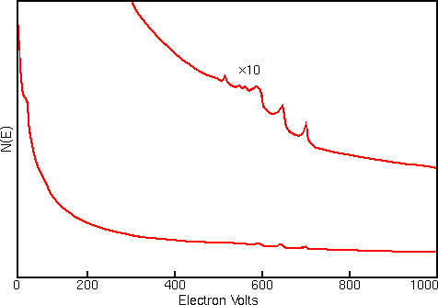
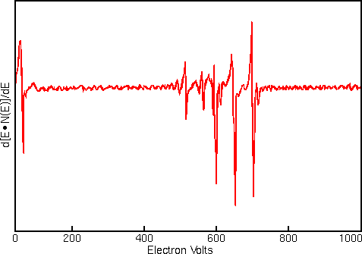
AES-differential spectrum
Auger electron spectrum
Instead of a N(E) vs E plot, we normally take the first differential spectrum, d[ExN(E)]/dE vs E for analysis since it clarifies some of the spectral details.

Slide 13
The physics of different electron sources
AES-Electron source
In order to get the best signal out of our sample we have to put the best signal in.
First type: Thermionic source, produces electrons when heated
Second type: a field-emission source. Emits electrons under high electron field
Tungsten cathode source
Lanthanum hexaboride (LaB6) cathode source

Slide 14
AES-Electron source: thermionic emission
Heating any material to a high enough temperature, electrons got sufficient energy to overcome the natural barrier (Work function Φ) that prevents them from leaking out.
Richardson’s Law, J=AT²e^{-Φ/KT} . J is current density, A is Richardson’s constant, which depends on the source materials, K is Boltzmann constant
Refractory materials (W) and those (LaB₆) with an exceptionally low work function is good for filament.
Thermionic sources: W hairpin, LaB₆ and other low-Φ materials.

Slide 15
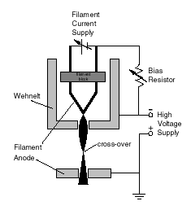
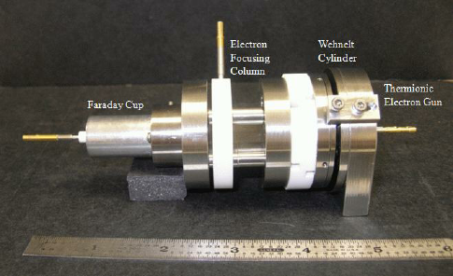
AES-thermionic electron source setup

Slide 16
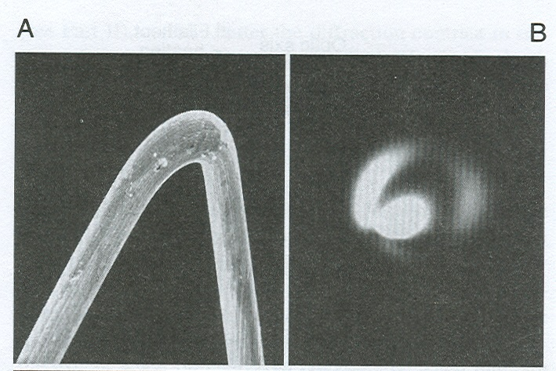
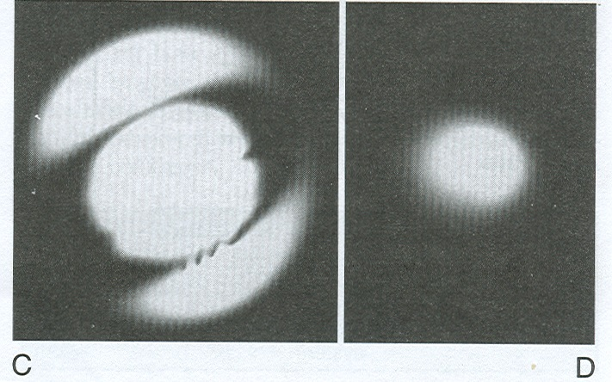
(A) The tip of a W hairpin filament and the distribution of electrons when the filament is (B) under-saturated and misaligned (C) under-saturated and aligned (D) saturated.
AES-thermionic electron source: W filament
A tungsten cathode source consists of a wire filament bent in the shape of a hairpin. The filament operates at ~2700 K by resistive heating. The tungsten cathodes are widely used because they are both reliable and inexpensive. Current densities are only about 1.75 A/cm².

Slide 17
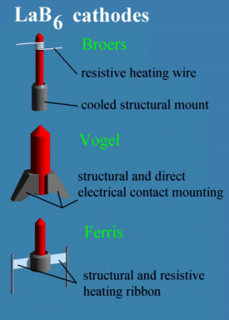
AES-thermionic electron source: LaB6
Lanthanum hexaboride (LaB₆) cathodes provide higher current densities (brightness) because LaB₆ has a lower work function and greater emissivity than tungsten. At 2000 K, current densities of ~100 A/cm² are available. Higher current densities provide narrower electron beams useful for analyzing smaller features.

Slide 18
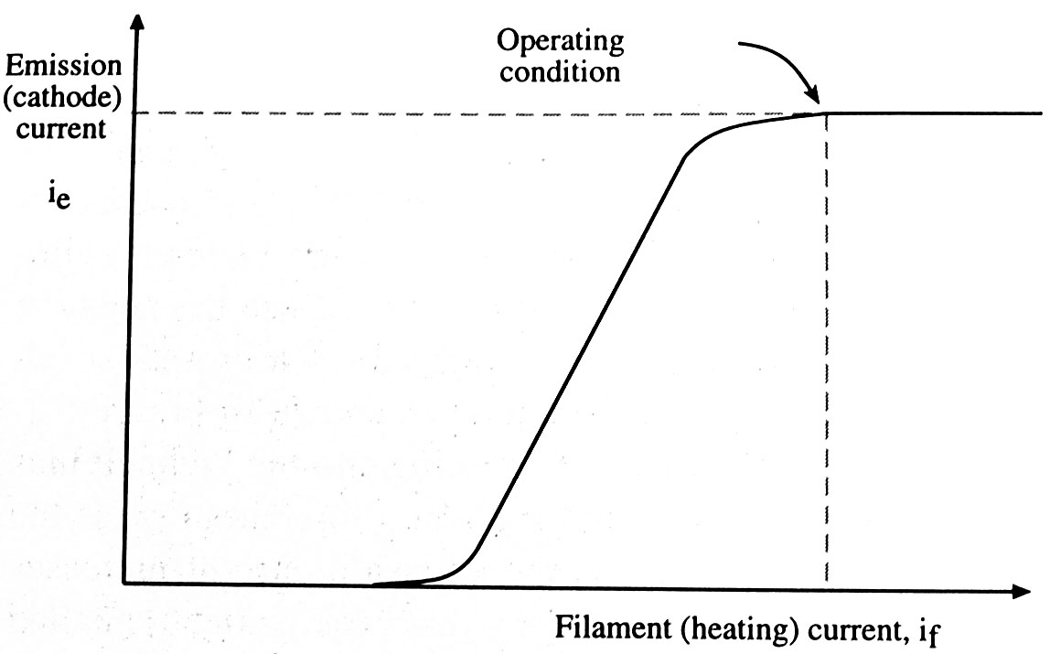
AES-thermionic source
Electron emission current increases with the filament heating current
A maximum emission current termed saturation is reached when the heating current is high enough
All thermionic sources should be operated at or just below saturation.

Slide 19
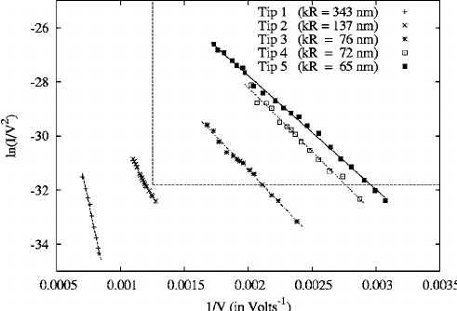

AES-Electron source: Field emission principle
Field emission is the process where electrons escape from a material's surface into a vacuum when a very strong external electric field is applied, causing the energy barrier to become thin enough for electrons to "tunnel" through it quantum mechanically, rather than needing heat to overcome it.
The field electron emission is commonly described by the Fowler-Nordheim (FN) equation.
J is the current density (A/m2)
F is the local electric field (V/m)
is the work function (eV)
A, B are constants related to fundamental physical constants and material properties
$$J∝ A F^{2}\exp{(−\frac{Bφ^{3/2}}{F})}$$

Slide 20
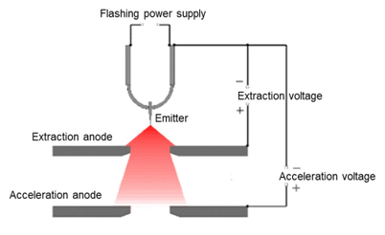
AES-Electron source: Field emission source
Field emission electron sources consist of very sharp tungsten points at which electrical fields can be >10⁷ V/cm. At these fields, electrons tunnel directly through the barrier and leave the emitter. Field emission guns provide the brightest beams (10³ to 10⁶ A/cm²). Electron beams as narrow as 10 nm provide Auger analysis of small features.

Slide 21
AES-Electron source: Field emission source
However, the high electric field impose severe stress on the tip and materials should be strong.
Usually a sharp W tip was used.
A W tip, showing the extraordinarily fine W needle.
The radius of the tip apex is usually smaller than 100nm
250um
An SEM image of a W tip

Slide 22
AES-Electron source: Field emission source
Strength of an electric field E is related to the voltage V applied to the (spherical) point of radius r as E=V/r
High electric field lowers the work function barrier sufficiently for electrons to tunnel out of the material.
For a W tip, r<100nm, 1kV potential: E>10¹⁰V/m
Δφ (image-force barrier lowering) arises from the classical electrostatic attraction between the emitted electron and its induced image charge in the metal surface, which rounds off the top of the triangular barrier and reduces the effective barrier height.

Slide 23
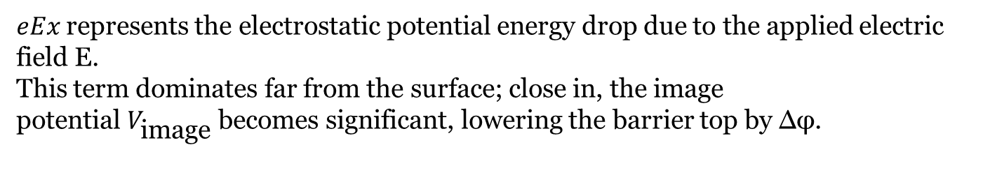
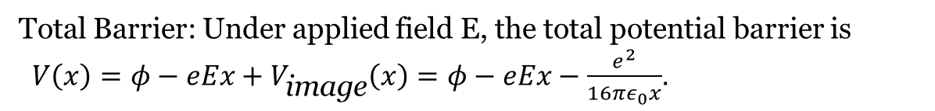
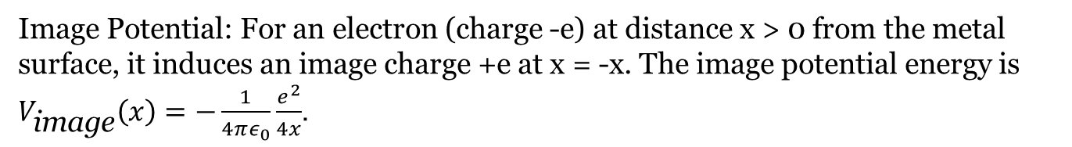
Image Potential: For an electron (charge -e) at distance x > 0 from the metal surface, it induces an image charge +e at x = -x. The image potential energy is
$V_{\text{image}}\left(x\right)=−\frac{1}{4πε_{0}}\frac{e^{2}}{4x}$.
Total Barrier: Under applied field E, the total potential barrier is
$V\left(x\right)=φ−eEx+V_{\text{image}}\left(x\right)=φ−eEx−\frac{e^{2}}{16πε_{0}x}$.
$eEx$represents the electrostatic potential energy drop due to the applied electric field E.
This term dominates far from the surface; close in, the image potential $V_{\text{image}}$ becomes significant, lowering the barrier top by Δφ.
Barrier Maximum: Set $\frac{dV}{dx}=0$ to find the peak at $x_{0}=\sqrt{\frac{e}{16πε_{0}E}}$.
Substitute $x_{0}$ into V(x₀), yielding $Δφ=\frac{e^{2}}{16πε_{0}x_{0}}=e\sqrt{\frac{∣E∣}{4πε_{0}}}$.

Slide 24
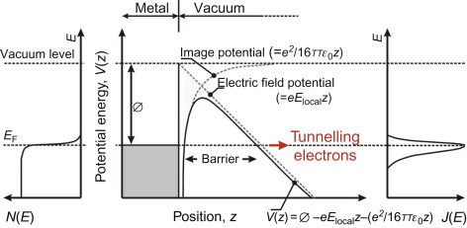

Slide 25
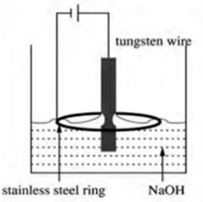
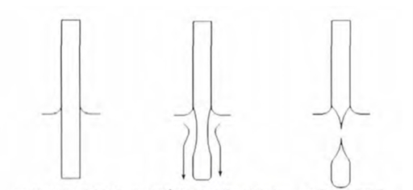
How to make a sharp W tip
Chemical etching method for making sharp W tips
Highest current density
Necking
Flow of tungsten ions

Slide 26
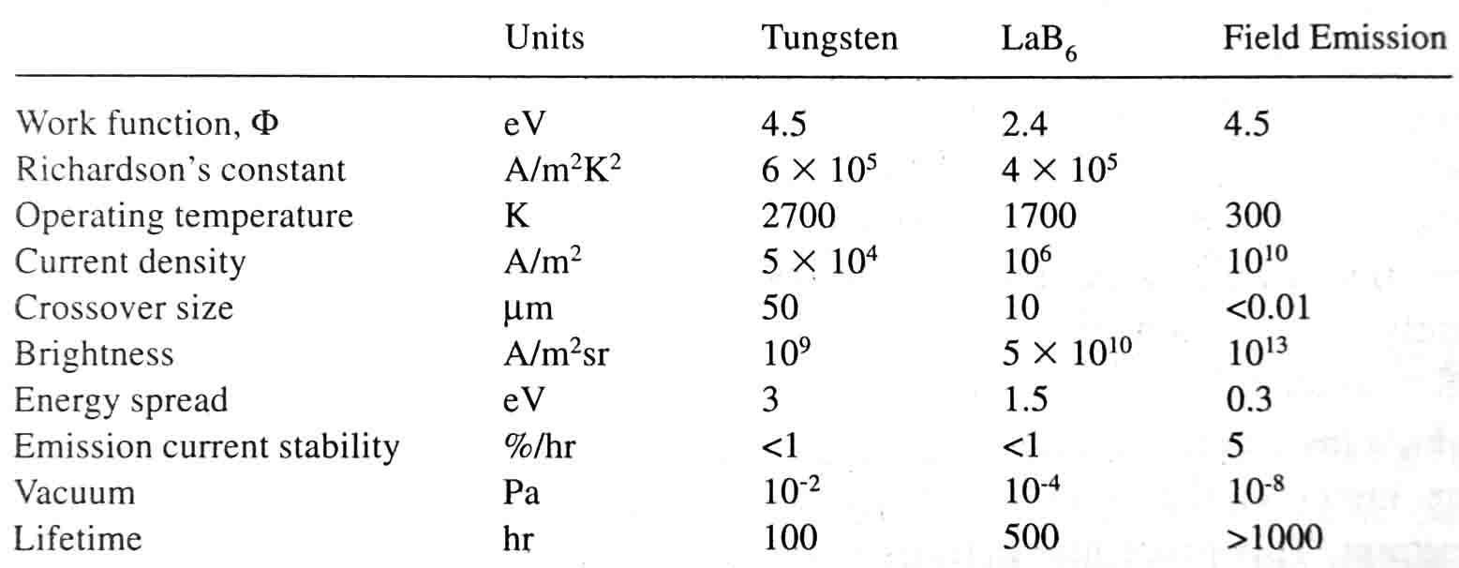
AES-Comparison of e-guns
Characteristics of the three principal sources operating at 100 keV.

Slide 27
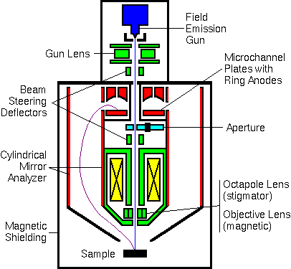
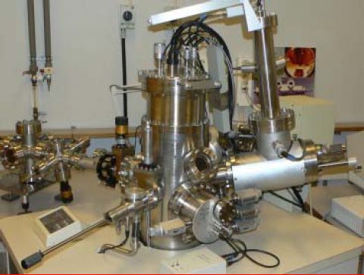
AES-Instrumentation
Cylindrical Mirror Analyzer (CMA)
Electron source
Electron analyzer
Electron Multiplier
Lock-in amplifier
Auger electron spectrometers use electron multipliers similar to those used in XPS. The AES electron multipliers usually operate in pulse counting mode which records every electron as it arrives at the detector.

Slide 28
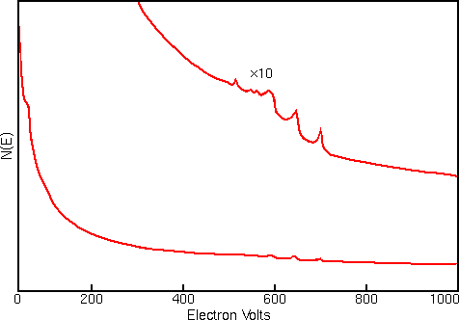
AES Data Display Algorithms
Strong interfering signals (background) accompany the Auger electrons in all regions of the Auger spectrum.
The interference includes contributions from
Secondary electrons
backscattered electrons
Auger electrons that have lost energy as they escape from beneath the sample surface.
The figure shows a typical AES spectrum (of iron) plotted as total electron signal, N(E), versus electron kinetic energy. The Auger peaks are obscure even after expanding the vertical scale.

Slide 29
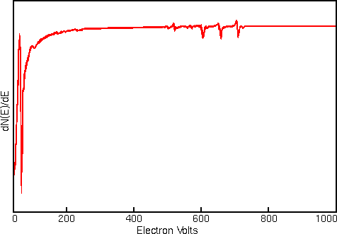
AES Data Display Algorithms
Displaying Auger spectra as derivative enhances the sharp Auger peaks and deemphasizes the relatively intense and structureless background.
Plotting the spectrum as the derivative of the electron energy distribution dN(E)/dE, clarifies some of the spectral details.
To get the derivative form of Auger spectrum, a Lock-in amplifier is used.
Notes:
Modulation: A small AC modulation voltage is added to the DC ramp of the electron energy analyzer.
Detection: The detector picks up a signal containing both the DC background and the AC response.
Differentiation: The lock-in amplifier measures the amplitude of the signal at the modulation frequency. Mathematically, this amplitude is proportional to the first derivative of the energy distribution ($dN{\left(E\right)}/dE$(
While modern instruments often acquire direct intensities and differentiate them digitally using algorithms, the lock-in technique remains a fundamental method for direct analog differentiation with high signal-to-noise ratios.

Slide 30
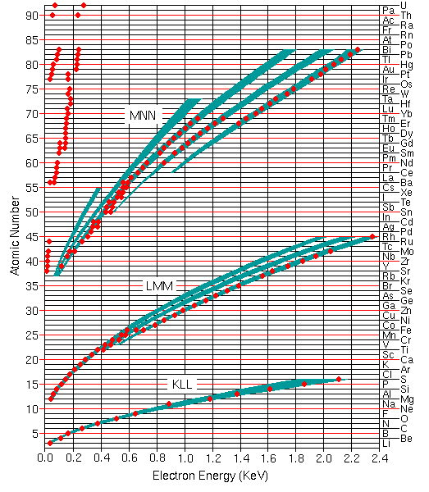
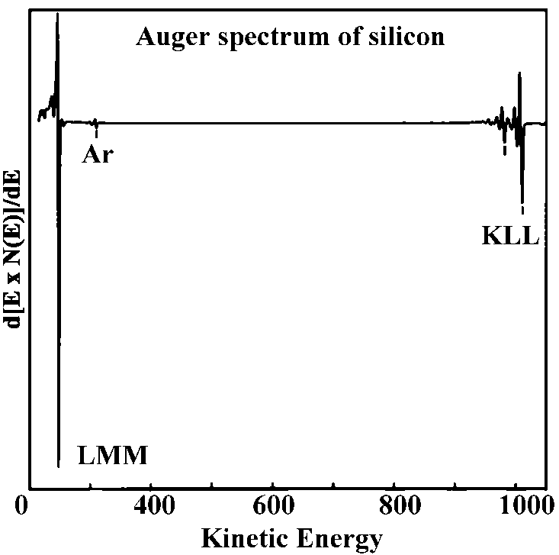
Spectral interpretations – Qualitative analysis
Qualitative analysis
Qualitative analysis by Auger electron spectroscopy depends on identification of the elements responsible for the various peaks in the spectrum. The figure shows the most useful Auger peaks in the KLL, LMM, and MNN parts of the spectrum as well as higher transitions for elements above cesium. The red dots indicate the strongest and most characteristic peaks

Slide 31
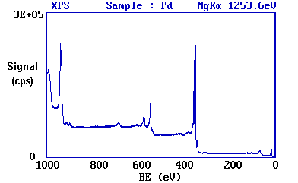
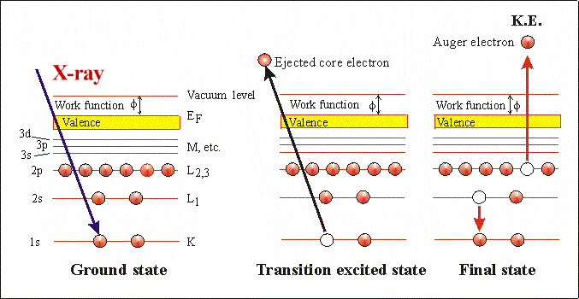
BE = hv - KE -φ
AES
KE = ( BE_{K} - BE_{L1} ) - BE_{L23} -φ

Slide 32
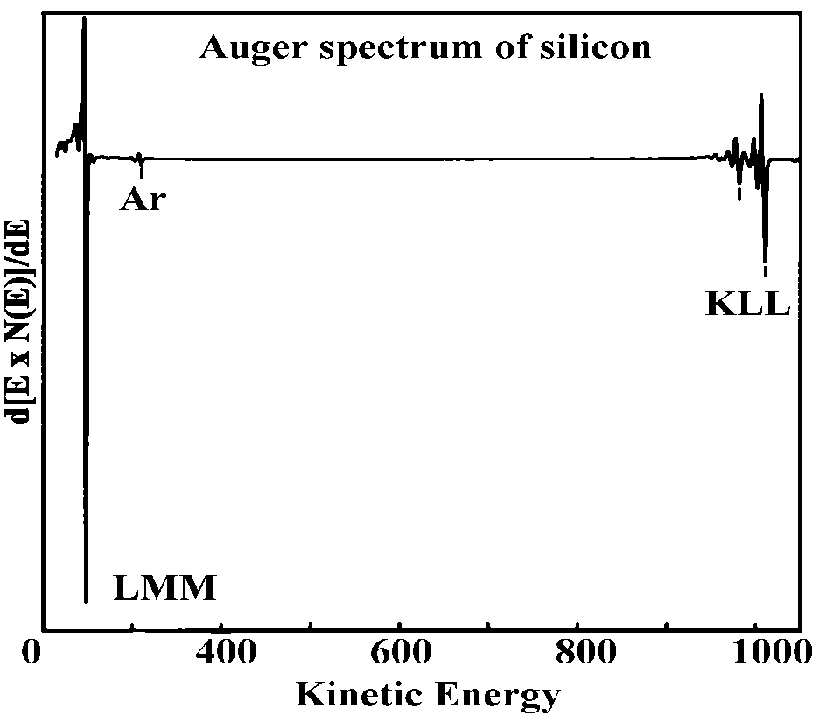
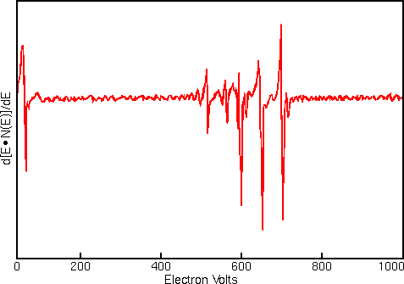
Spectral interpretations – Qualitative analysis
Group of peaks
FeCr

Slide 33
4f
For MNN Auger peaks, we may have:
4d
M1N1N1
M1N1N2
M1N1N3
M1N1N4
……
M1N2N2
M1N2N3
M1N2N4
……
M2N1N1
M2N1N2
M2N1N3
……
M3……
4p
4s
3d
3p
3s
2p
2s
1s

Slide 34
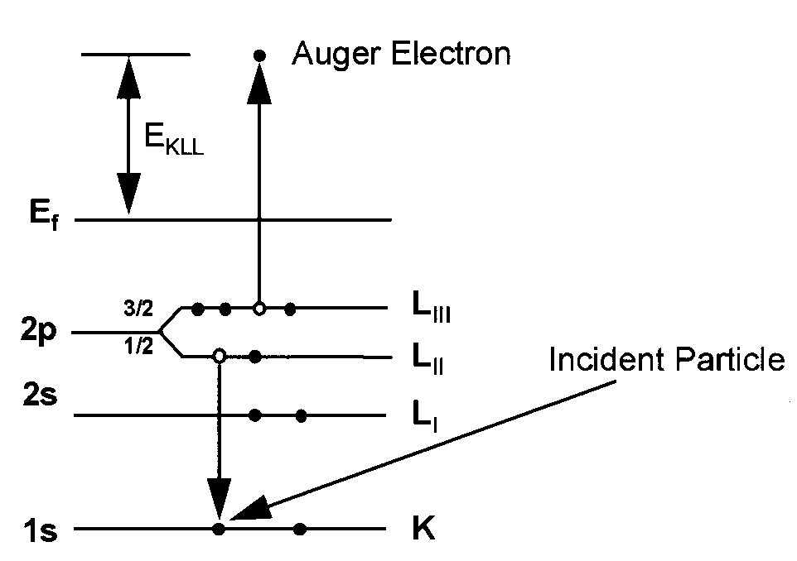

Spectral interpretations– Qualitative analysis
Energy of Auger transition
$$E_{ABC}=E_{A}\left(z\right)−E_{B}\left(z\right)−E_{C}(z)$$
where E_{A}, E_{B}, and E_{C} are the binding energies of electrons in the three levels
The binding energy of a level in the presence of a core hole is greater than the that of the same level in a neutral atom, so that both E_{B} and E_{C} need to be corrected
For approximation, the following equation was used to estimate the kinetic energy of Auger electrons (z: atomic number of the atom). This is taken into consideration of core-hole and screening effect

Slide 35
Spectral interpretations– Qualitative analysis
Classroom exercise
Calculate the kinetic energies of KLL Auger peaks from a clean polycrystalline Al surface with information provided below
Al BE of 1s [K] electrons = 1559.6 eV
Al BE of 2s [L1] electrons = 117.7eV
Al BE of 2p [L23] electrons = 73.1 eV
Si BE of 2s [L1] electrons = 148.7 eV
Si BE of 2p [L23] electrons = 99.2 eV
Work function of polycrystalline Al= 4.2 eV

Slide 36
Spectral interpretations– Qualitative analysis
Classroom exercise solution
E_{k}= 1559.6 eV
E_{L1}=0.5 (117.7 +148.7)= 133.2 eV
E_{L23}= 0.5 (73.1 + 99.2) = 86.15 eV
E (KL1L1)= 1289 eV
E(KL1L23)=1336.05 eV
E(KL23L23)= 1383.1eV
Notes:
There are three possible KLL transitions
KL1L1, KL1L23, KL23L23

Slide 37
Spectral interpretations – Qualitative analysis
Element identification
General elemental identification procedure
1. Concentrating on the major peaks and comparing the peak positions with Auger electron energy chart or table.
2. Referring to the standard spectra of the elements in question and making positive identification of major constituents.
3. Labeling all peaks related to the identified major constituents.
4. Repeat 1-3 for other unlabelled peaks.

Slide 38
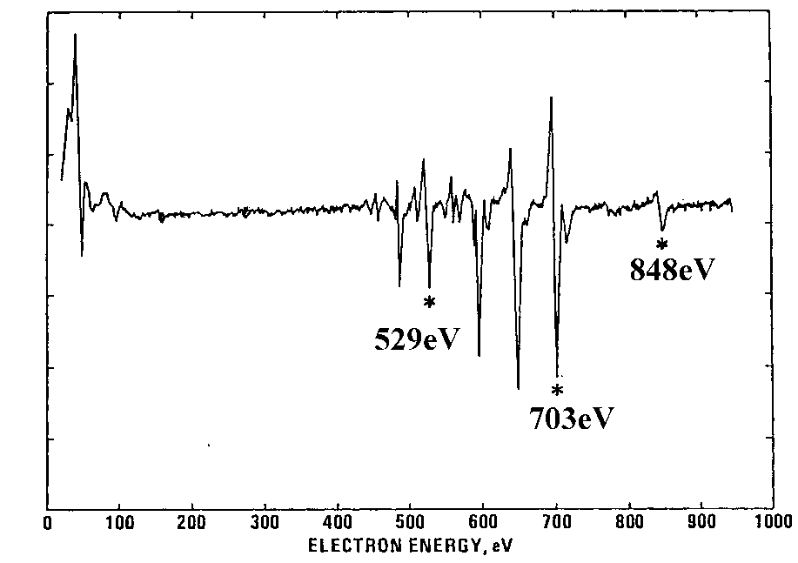
Spectral interpretations – Qualitative analysis
Element identification
Ni, Fe and Cr are preliminarily identified.
http://srdata.nist.gov/xps/main_search_menu.aspx

Slide 39
Spectral interpretations – Qualitative analysis
Element identification

Slide 40
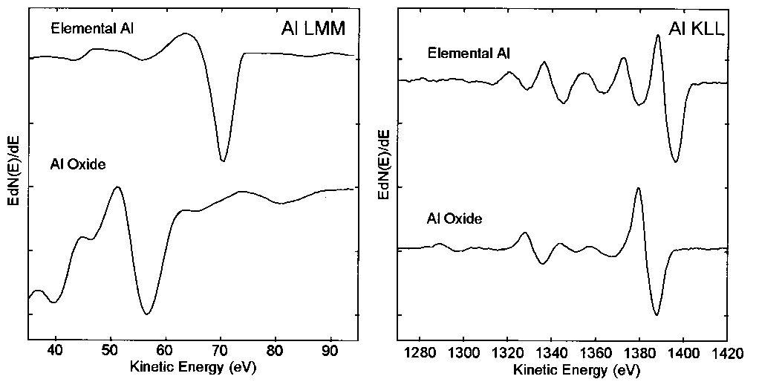
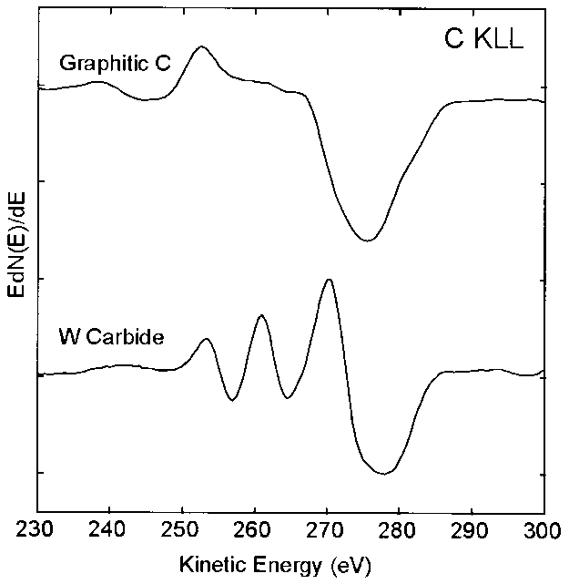
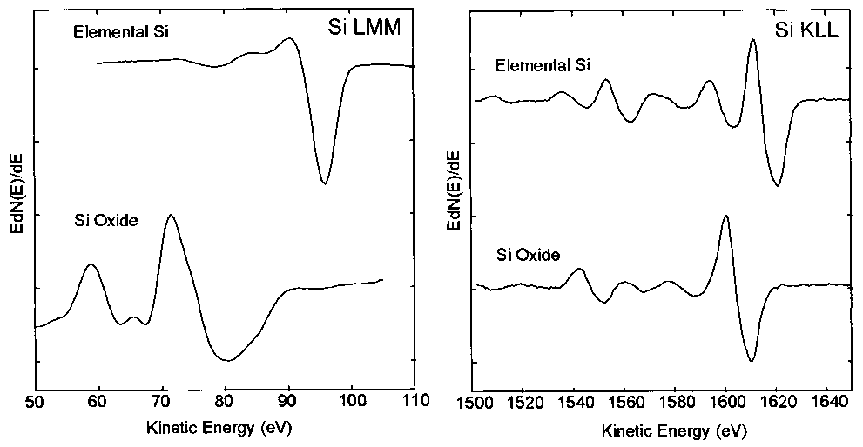
Spectral interpretations – Qualitative analysis
Chemical state information
The energy position and shape of an Auger peak contains information about the chemical environment.
Theoretical predictions are difficult. Reference spectra are often used for comparison.
Notes:
Factor to consider not only include the core-hole effect, but also the final state relaxation

Slide 41

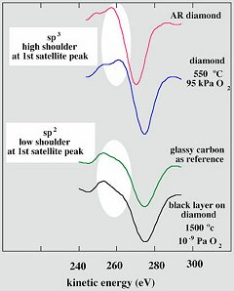
Spectral interpretations – Qualitative analysis
Chemical shift. The chemical shift could be quite complex since 3 orbitals are involved in a single Auger transition.
KE = ( E_{K} – E_{L2} ) - E_{L3}
Auger Line shape Analysis:
If the valence band is involved.
Density of state(DOS) of the band will affect the peak shape and width.
The energy loss mechanism changed
The shape of the low energy part of the peak will also change.

Slide 42
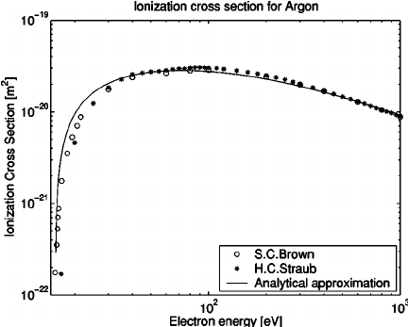
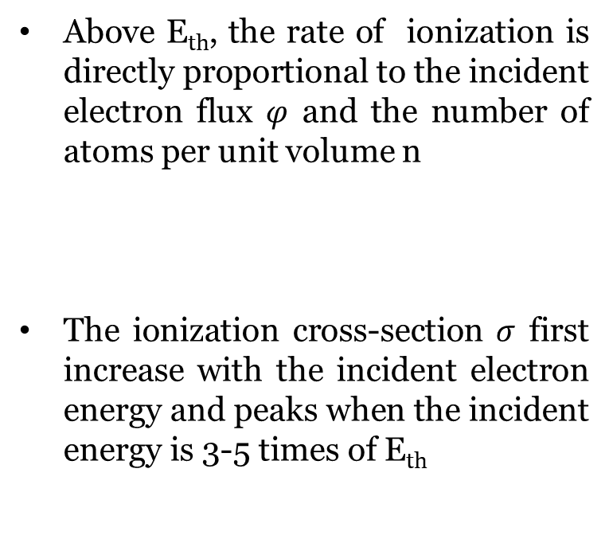

Spectral interpretations – Quantitative analysis
Ionization cross-section
Auger transition of a given type can be initiated only after a given core electron is ionized.
A minimum (threshold) energy E_{th} is required for the incident electrons for the intended excitation
Above E_{th}, the rate of ionization is directly proportional to the incident electron flux $φ$ and the number of atoms per unit volume n
The ionization cross-section $σ$ first increase with the incident electron energy and peaks when the incident energy is 3-5 times of E_{th}
$$\frac{dn}{dt}=nφσ$$
Notes:
If possible, one wish to use not so large incident electron energy
We are interested in Auger transitions due to inner shell ionization of energy less than 1500eV, the primary electron energy is usually restricted to 5-10 KeV

Slide 43
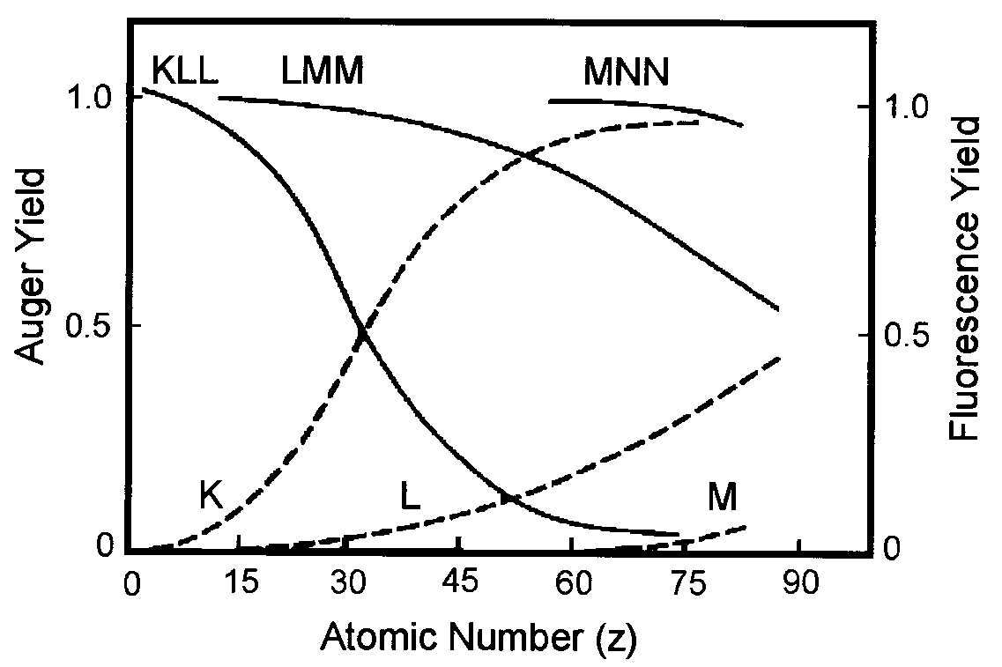
Spectral interpretations – Quantitative analysis
Auger yield
The Auger process competes with the x-ray fluorescence process in an excited ion.
Total of Auger and XRF yields is 1.
For KLL, the P_{X} overtakes P_{A} when the atomic number is greater than 32
Auger electron emission is the more probable decay mechanism for low energy transitions (<1.5 keV)
  Low atomic number elements (K shell)
  High atomic number elements (L/M shell)
By choosing an appropriate Auger transition, all elements (except H and He) can be detected.

Slide 44
Backscattering
The majority of incident electrons will penetrate into the sample with some of them backscattered and come back to surface region, exciting the Auger process if they have enough energy.
The contribution to Auger signal depends on the incident electron energy and the backscattering probability, which is a function of the atomic number of the specimen.
Primary electrons
Auger electrons by backscattering
Auger electrons by direct beam
Specimen surface

Slide 45
Classroom exercise
One deposits a thin film of molybdenum (42) onto a tungsten (74) substrate and monitors the Mo Auger peak intensity.
At small Mo thickness, the Auger signal increase linearly with the thickness. However, with further increase in the film thickness, the Auger signal reaches a maximum and then decrease slowly to the steady state value of the bulk Mo. The Auger signal at the maximum is ~20% than that obtained from bulk Mo. How to understand this?
Mo Auger intensity
Mo thickness

Slide 46
Spectral interpretations – Quantitative analysis
Signal quantification
For a homogenous sample, the measured Auger intensity is given by:
I_{p} is the incident electron intensity
γ_{i} is the Auger transition probability for ABC transition of element i
r is the secondary ionization by scattered electrons

Slide 47
Spectral interpretations – Quantitative analysis
Signal quantification

Slide 48
Spectral interpretations – Quantitative analysis
Signal quantification

Slide 49
Spectral interpretations – Quantitative analysis
Auger peaks are almost always on sloping background → Asymmetry in peak shape.
Quantitative measurement of Auger peak intensities is, by convention, done on the high-energy part of the peak.
If a Lock-in amplifier is used:
Peak height depends on size of the modulation used to differentiate it.
If modulation voltage is too high, peak shape is distorted

Slide 50
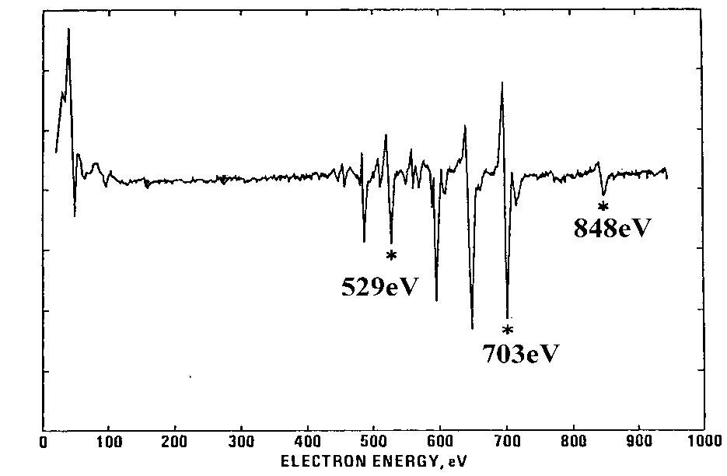
Spectral interpretations – Quantitative analysis
Signal quantification
The empirical method does not include the matrix effect of the sample, which includes the inelastic mean free path (λ), the backscattering factor (ρ), chemical effect on peak shapes and surface roughness. Generally, an error of 15% is expected using the empirical method.
For example, a sample reported with 80% Fe and 20% Ni. The error for Fe could be in the range of ±12%.
If standard sample with the same matrix is used for the determination of the sensitivity factors, the error can be as small as 1%.

Slide 51
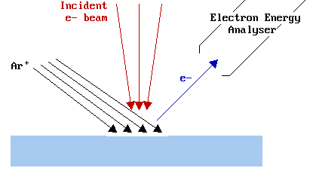
Spectral interpretations – Quantitative analysis
Depth Profiling
AES uses the same methodology of depth profile as XPS. Both sputtered or angle-resolved depth profiles can be applied in AES.
To obtain information about the variation of composition with depth below the surface of a sample, it is necessary to gradually remove material from the surface region being analysed, whilst continuing to monitor and record the Auger spectra.
This controlled surface etching of the analysed region can be accomplished by simultaneously exposing the surface to an ion flux which leads to sputtering (i.e. removal) of the surface atoms.

Slide 52
Spectral interpretations – Quantitative analysis
Depth Profiling

Slide 53
Analysis Procedure
Conducting solids (metals, alloys, semiconductors, thin films) with dimensions less than 2 cm diameter and 1 cm high may be analyzed. Samples must be clean and free from any high vapor pressure material. It is important that the specimen surface should not be handled.
Limitations
Samples must be conductive, Samples must be solid and vacuum compatible. Insulating samples can be more difficult. Because Auger is a surface sensitive technique, gold or carbon coating must be avoided.
Qualitative detection sensitivity is reliable to ~1.0 atomic percent depending on the element
Beam damage possible with some materials
Accuracy of quantitative analysis is limited to ± 20% if published sensitivity factors are used, better quantification is possible if standards closely resembling the sample are used
Elements H and He are undetectable

Slide 54
Scanning Auger
Electrons can be focused to a spot of < 1 nanometer
Penetration depth and scattering within solid typically limit resolution to ~20 nanometer. Recent instruments claim resolution of ~ 6 nm.
Often use hemispherical analyzer
Electron energy
Analyzer
The details of the Electromagnetic lens will be discussed in the Lecture of electron microscopy

Slide 55
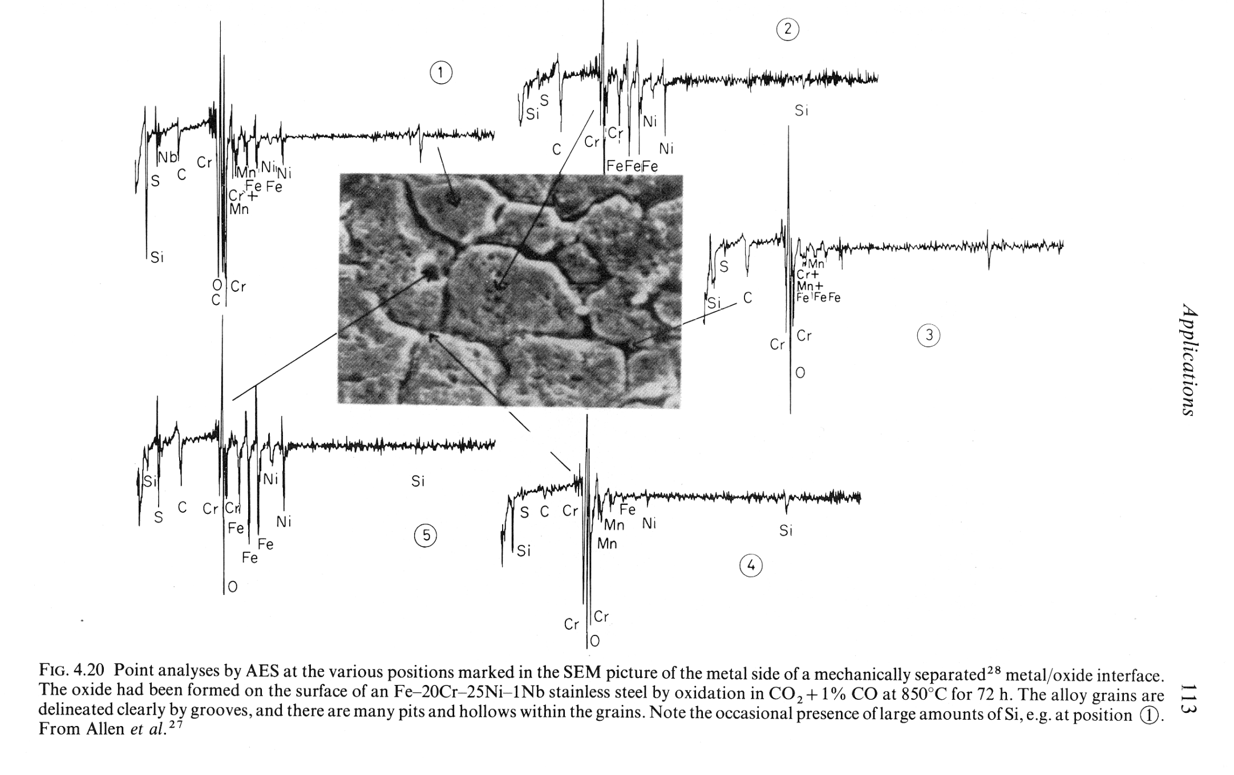

Slide 56
Spectral interpretations – Qualitative analysis
SEM and Auger images
160 kX SEM
100 kX SEM
Au islands on C

Slide 57
Homework 2

